Slide 1

BANKING APP
WITH JDBC
Anjali Mahajan

Slide 2
CONTENT
01
JAVA
02
JDBC CONNECTIONS
03
SCOPE OF PROJECT
04
PROJECT CONFIGURATIONS
05
DEPENDENCIES
06
FUNCTIONAL REQUIREMENTS
07
OPERATING ENVIRONMENT USED
08
HIERARCHY OF PROJECT ARTIFACTS

Slide 3


Java
Java is a general-purpose, high-level programming language and computing platform.
Java is designed to be platform-independent, meaning that Java programs can run on any device or platform that has a Java Virtual Machine (JVM) installed.
Here are some key characteristics and features of Java:
Platform Independence : which can be executed on any device with a compatible Java Virtual Machine (JVM).
Object-Oriented: Java is an object-oriented programming (OOP) language, promoting the use of classes and objects for code organization and design.
Simplicity and readability: Java syntax is designed to be easy to understand and read.
.

Slide 4
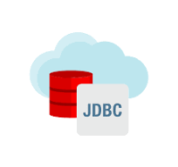
JDBC
Java Database Connectivity (JDBC) is a Java-based API (Application Programming Interface) that provides a standard interface for connecting Java applications with relational databases.
Here are some key aspects of JDBC:
Connection Establishment: JDBC facilitates the establishment of a connection between a Java application and a relational database.
Statement Execution: JDBC allows the execution of SQL statements and queries.
Result Retrieval: JDBC provides methods to retrieve results from executed SQL queries.

Slide 5
SCOPE OF PROJECT
Objective: Develop a java based system to process bank ‘Transactions’ using data from the ‘Transaction’ Tables. The system will update ‘NewBal’ and ‘TransStat’ based on transaction details and log information into separate tables (‘Validtrans’ and ‘Invalidtrans’ ).
This latter will contain ‘transID’ , ‘Transtype’ , ‘TransAmt’ , and ‘Validity’
.
3. Components:
Java Code:
Responsible for data retrieval, transaction processing, and logging.
Ensures proper error handling and security measures.
Transaction Database Table:
Contains raw transaction data.
ValidTrans Database Table:
Stores valid transactions.
InvalidTrans Database Table:
Stores invalid transactions.
2. Features:
Data Retrieval:
Fetch transaction data from the Transaction table.
Transaction Processing:
Update NewBal based on the formula: NewBal = OldBal (+ -) TransAmt.
Determine TransStat based on the calculated NewBal.
Logging:
Log valid transactions into the ValidTrans table.
Log invalid transactions into the InvalidTrans table.
4. Functional Requirements:
Data Retrieval:
Fetch transaction data from the Transaction table.
Transaction Processing:
Calculate NewBal based on the transaction details.
Determine TransStat based on the calculated NewBal.
Logging:
Log valid transactions into the ValidTrans table.
Log invalid transactions into the InvalidTrans table.
Error Handling:
Implement robust error handling for database connectivity issues, SQL
exceptions, and unexpected data inconsistencies.

Slide 6
Project CONFIGs
Database Connection Configuration
Connection String i.e., JDBC URL
Project Specific Configuration

Slide 7
DEPENDENCIES
Ojdbc5.jar: It’s a Config File to make Oracle Driver Available.
OracleDriver:
Transnames.ora:
OracleDriver is a class in the Oracle JDBC (Java Database Connectivity) driver implementation provided by Oracle. It is part of the Oracle JDBC Thin Driver, which is a pure Java driver for Oracle Database that does not require Oracle client software to be installed on the client machine.
The tnsnames.ora file is a configuration file used by Oracle Database clients to define database connection information. It contains a list of net service names mapped to a set of connection details, such as the host address, port, and service name.
This file is part of Oracle's Transparent Network Substrate (TNS), which helps manage and define connections to Oracle Databases.

Slide 8
COMPONENTS
BankFinalProject
BASE CLASS

Slide 9
Utility Methods
updateTransaction
logTransaction
processTransactions
Method 1
Method 2
Method 3
LOGIN PAGE 1
LOGIN PAGE 2

Slide 10
Method CHAINING
The set method provided by PreparedStatement Interface is a method chaining used to set parameters.
Method chaining in this context is possible because each method that sets a parameter (setInt, setString, setDouble, etc.)
It Also improves code readability.

Slide 11
REQUIREMENT ID | REQUIREMENT CATEGORY | REQUIREMENT TYPE | PRIORITY | HIERARCHY | REF
R001 | FUNCTIONAL | STATED | HIGH
REQUIREMENT DESCRIPTION | ESTABLISHING DATABASE CONNECTION
SCOPE | Load the Database driver Establish the connection Create Statement Execute the Statement Retrieving data Close connection
REQUIREMENT METHODOLOGICAL DETAILS | getConnection() method of Driver Manager Class Ex : DriverManager.getConnection(ConnectionURL, Username, Password); ConnectionURL = jdbc:oracle:thin:@localhost:1521:XE jdbc is the API, oracle is database, thin is database driver type @loacalhost is address of machine on which database server is running 1521 is the port num on which oracle is listening as an application XE is service name with which oracle is registered with OS

Slide 12

OPERATING ENVIRONMENT
01
02
03
JAVA
SQL
JDBC

Slide 13
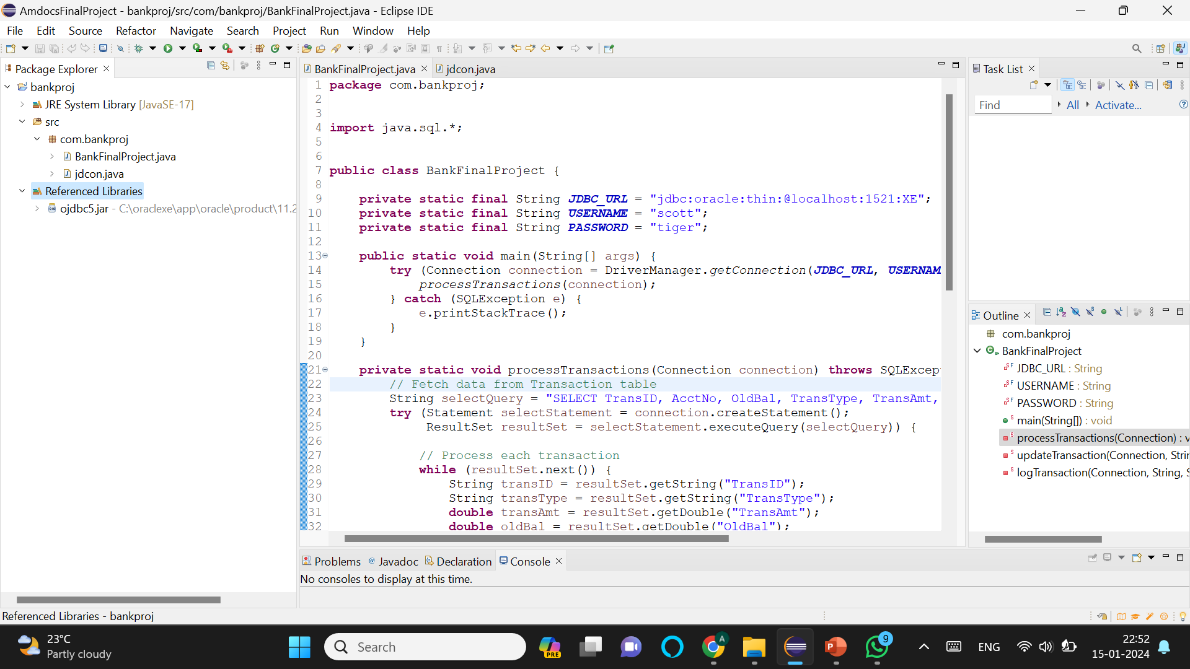
Hierarchy of Project Artifacts

Slide 14
THANK YOU
By :
Anjali Mahajan

